Slide 1



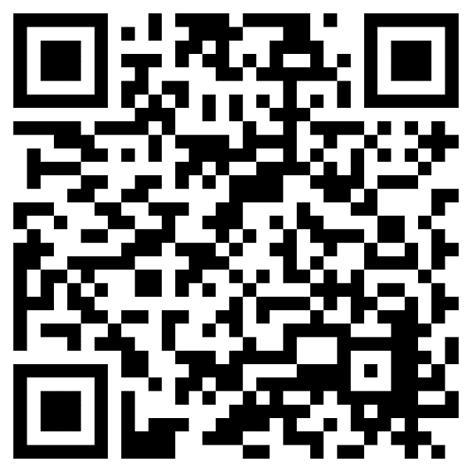

Join Women Talk Money
A free community for women, by women
A community for real talk and
helpful tips about money,
investing, careers, and more.
Hover your phone’s camera over
the code. NO APP NEEDED.
Investing involves risk, including risk of loss.
Fidelity Brokerage Services LLC, Member NYSE, SIPC, 900 Salem Street, Smithﬁeld, RI 02917
© 2024 FMR LLC. All rights reserved.
1134822.1.0

