Slide 1

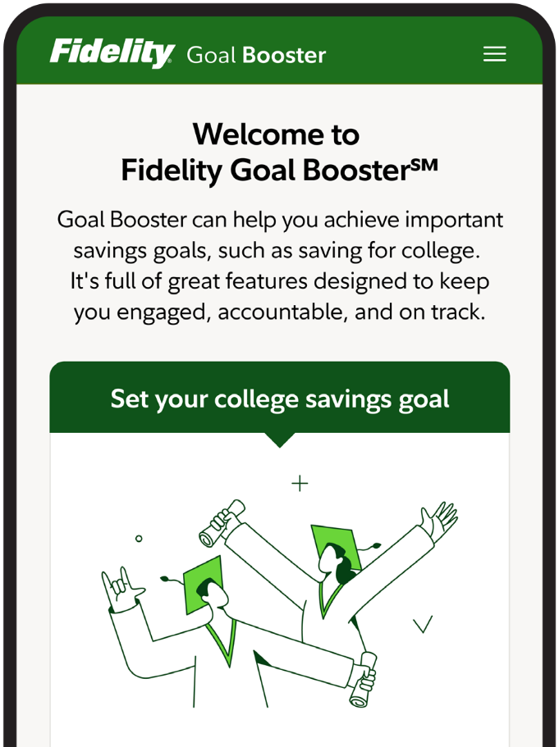
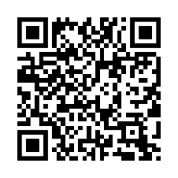
Give your college savings a boost.
Fidelity Goal BoosterSM can help break down big goals, like saving for college, into easily achievable steps:
Create your goal
Visit Fidelity.com/GoalBoosterCollege and set up your goal.
Put your money to work
Explore savings and investing options to see what works for you.
Fund. Fund. Fund.
[Plan sponsor] has enabled payroll-funding for Goal Booster so you can send money directly from your paycheck to your goal each pay period.
Start saving today and get closer to reaching your goal:
Scan the code
OR Text COLLEGE to 343898
OR Visit Fidelity.com/GoalBoosterCollege
Investing involves risk, including risk of loss.
Message and data rates may apply. Get details at Digital.FidelityInvestments.com/smsee. Screenshot is for illustrative purposes only.
All third-party trademarks and service marks are the property of their respective owners. Fidelity Goal Booster is a service mark of FMR LLC.
The Fidelity Investments and pyramid design logo is a registered service mark of FMR LLC. Fidelity Brokerage Services LLC, Member NYSE, SIPC, 900 Salem Street, Smithfield, RI 02917
© 2025 FMR LLC. All rights reserved. 1232236.1.0
PLAN SPONSOR LOGO

