Slide 1

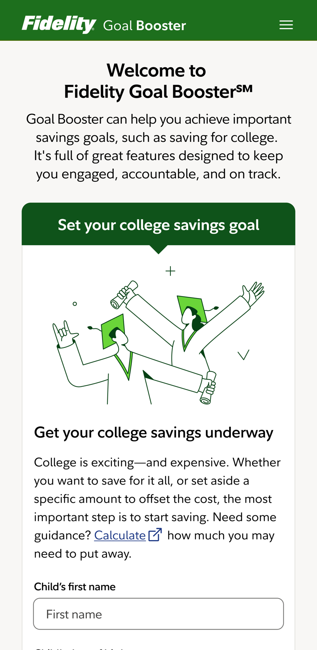
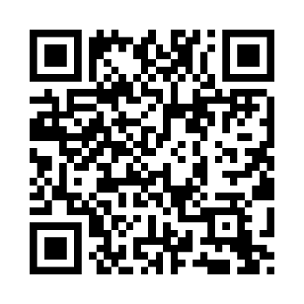

Go to the top of the class in college savings.
Fidelity Goal BoosterSM can help you build emergency savings—now it can help with college savings too.
And thanks to [plan sponsor], you can fund your goal right from your paycheck.
Scan the code or text COLLEGE to
343898 to learn more and get started.
Fidelity.com/GoalBoosterCollege
Message and data rates may apply. Get details at Digital.FidelityInvestments.com/smsee.
Screenshot is for illustrative purposes only.
All third-party trademarks and service marks are the property of their respective owners.
Fidelity Goal Booster is a service mark of FMR LLC.
The Fidelity Investments and pyramid design logo is a registered service mark of FMR LLC. Fidelity Brokerage Services LLC, Member NYSE, SIPC, 900 Salem Street, Smithfield, RI 02917
© 2025 FMR LLC. All rights reserved. 1232234.1.0

