Slide 1


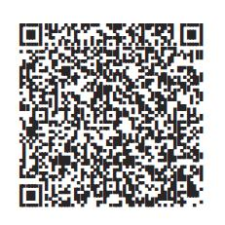
Scan here.
Enroll now.
Choose what’s right for you and your future.
Client logo 1.2”’x1.25”
On your break? Make it count and enroll in your <Workplace Savings Plan>.
Text Start to 343-898
Scan QR code below
Head to NetBenefits.com/Enroll
Questions about your plan? Go to NetBenefits.com or talk with a Fidelity representative at <XXX-XXX-XXXX>.
Investing involves risk, including the risk of loss.
<The Plan is intended to be a participant-directed plan as described in Section 404(c) of ERISA, which means that fiduciaries of the Plan are ordinarily relieved of liability for any losses that are the direct and necessary result of investment instructions given by a participant or beneficiary.>
Message and data rates may apply. Get details at Digital.FidelityInvestments.com/smsee.
Fidelity Brokerage Services LLC, Member NYSE, SIPC, 900 Salem Street, Smithfield, RI 02917
© 2025 FMR LLC. All rights reserved. 1211529.1.1

