Slide 1

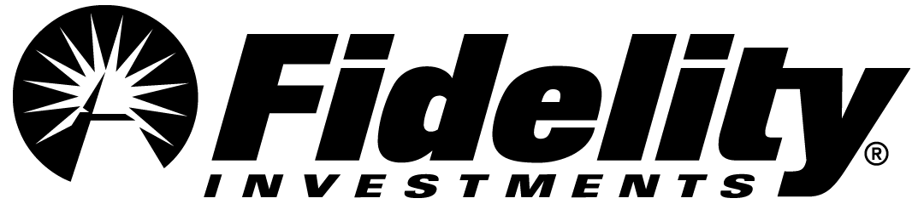
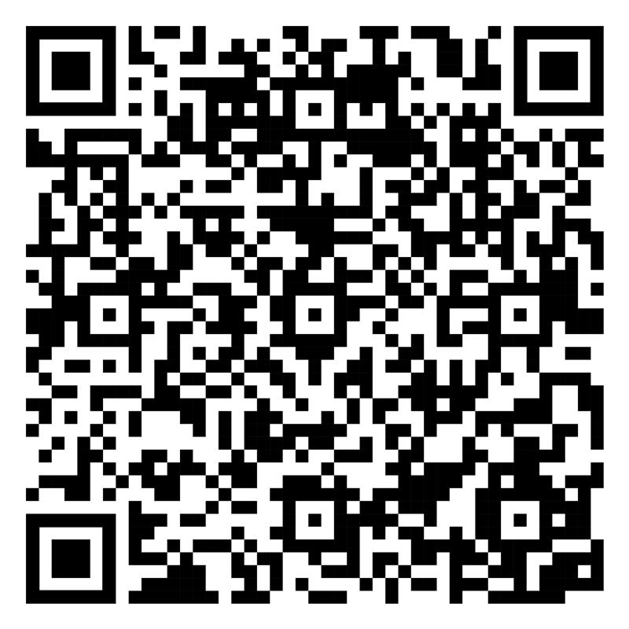
Create a future based on your needs
This Pride Month, find a range of resources designed to help you reach your financial goals.
Scan the code or visit
Fidelity.com/lgbtq+
to learn more.
Investing involves risk, including risk of loss.
The Fidelity Investments logo is a registered service mark of FMR LLC.
Fidelity Brokerage Services LLC, Member NYSE, SIPC, 900 Salem Street, Smithfield, RI 02917
© 2026 FMR LLC. All rights reserved. 1143859.4.0

