Slide 1


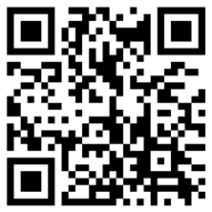
Enroll in the <Plan Name> today
As a valued employee, you’re eligible to participate in the <Plan Name>!
To start, you’ll need to:
Register your account if you’re new to Fidelity Investments: Verify your information, including date of birth and the last four digits of your Social Security number.
If you’ve had a Fidelity account before, login using your existing username and password to see your <Plan Name> account.
Choose your savings rate: Contributions can be automatically deducted from your paycheck, and you can make changes at any time.
Select your investments: Your investments can potentially grow, and you keep the money saved – even if you change jobs.
Add beneficiary designations: Click the Profile link, then select Beneficiaries and follow the online instructions.
Not sure what to do? Call 800-603-4015 to talk with a planning consultant or schedule an appointment to connect 1 on 1.
Enroll Today!
Questions about
your plan?
Review the Plan Highlights by logging into Netbenefits.com, select the savings plan, then Plan Information and Documents.
Three ways to enroll:
Scan the code to the right
Go to NetBenefits.com/Enroll
Or text Start to 343-898
Message and data rates may apply. Get details
at Digital.FidelityInvestments.com/smsee.

Slide 2
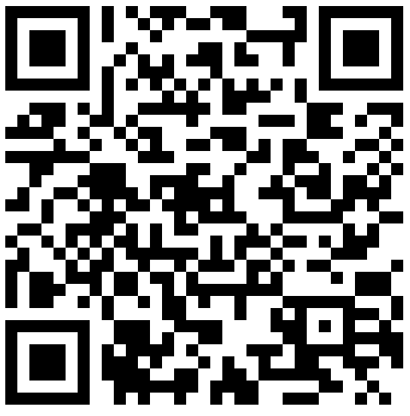


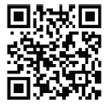
The Power of Small Amounts
The earlier you start saving, the more time your money has the potential to grow. Your workplace savings plan offers compound growth on your savings. That means your money could grow faster, because your interest can earn even more interest if it stays invested. Think of it like a snowball getting bigger as it rolls.
Try out our interactive experience and see for yourself!
The effect of $20 over 10 years*
Year
Prefer a mobile experience?
The NetBenefits app gives you more ways to access and manage your employee benefits. Download now!
Compatible with Apple® and Android®

