Slide 1





Your job demands that you take action. So does your retirement.
Take
CLIENT LOGO
action
NATIONAL RETIREMENT SECURITY <MONTH><WEEK>
<OCTOBER 2023><OCTOBER 15–21, 2023>

Slide 2
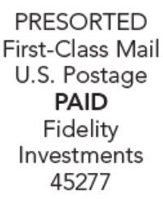
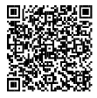
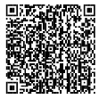
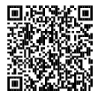
Taking some simple actions now can make a big difference to your financial future.
PO Box 145442
Cincinnati, OH 45250-5442
Make the most of National Retirement Security Month with three practical things you can do today:
Take steps to check your retirement savings
Review and complete a few steps to help ensure that your retirement plan is on point to meet your goals.
Get help from our support team
Fidelity representatives are at the ready to help you get the most from your retirement savings plan.
Download the NetBenefits® app
Securely access your account on the go, wherever and whenever you want, with our app.
Investing involves risk, including risk of loss.
Fidelity Brokerage Services LLC, Member NYSE, SPIC, 900 Salem Street, Smithfield, RI 02917
© 2023 FMR LLC. All rights reserved. 1099263.1.0

