Slide 1

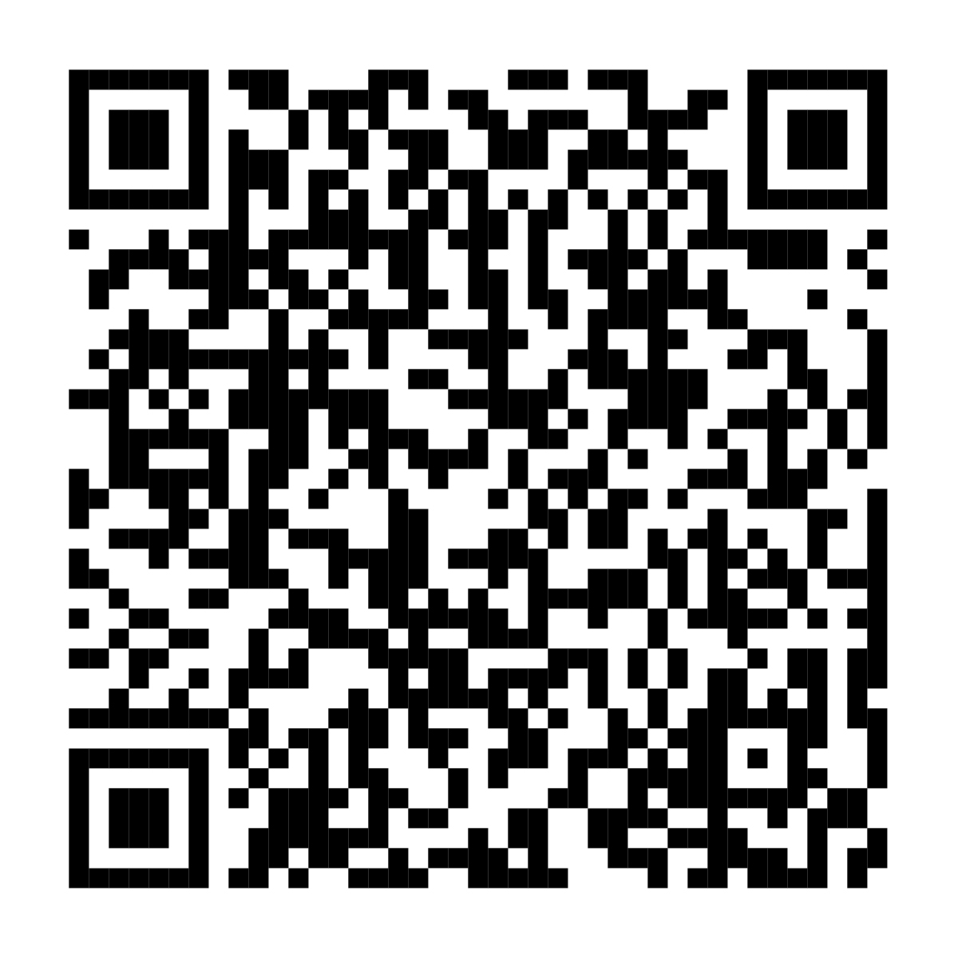
Explore your benefits options.
It’s time to enroll.
Annual Enrollment is now open through
<AE END DATE>.
When you log into NetBenefits, a simple, guided experience will
help you review, compare, and choose the options that best fit and support your total health and financial well-being.
Scan to enroll or visit
www.NetBenefits.com/healthbenefits
CLIENT LOGO
The trademarks and/or service marks appearing above are the property of FMR LLC and may be registered. The Fidelity Investments and pyramid design logo is a registered service mark of FMR LLC.
Fidelity Workplace Services LLC, 245 Summer Street, Boston, MA 02210. © 2025 FMR LLC. All rights reserved. 1216388.1.0

